Slide 1

Exploratory Data Analysis
Bank Marketing (Campaign)
15 August 2021

Slide 2
Week 13:Final Project Report
Individual Project: This project is done individually
Name:Nkululeko Freedom Mqadi
Email:mqadinf@gmail.com
Country:South Africa
College/Company:Deviare
Specialization:Data Science

Slide 3
Problem statement/Case Study
ABC Bank wants to sell its term deposit product to customers and before launching the product.
They want to develop a model which help them in understanding whether a particular customer will buy their product or not (based on customer's past interaction with bank or other Financial Institution).
Objective:
What is the reason for developing a machine learning model?
Bank wants to use ML model to shortlist customer whose chances of buying the product is more so that their marketing channel (tele marketing, SMS/email marketing etc.) can focus only to those customers whose chances of buying the product is more.
This will save resource and their time ( which is directly involved in the cost ( resource billing)).

Slide 4
The analysis is divided into the following sections:
Business Understanding
Data Understanding
Data Exploration
Exploratory Data Analysis
Recommendation summary
Model building
Model selection

Slide 5
Business understanding
ABC Bank is a banking institution in Portuguese that offers direct marketing campaigns which are phone call based.
As the marketing campaigns are phone call based, this presented some limitations
This resulted in decreasing the operating efficiency of the company.
Contacting many people takes a lot of time and therefore success rate is less.
The consumers that are being offered deposits, mostly are people using phone calls as a method of communication.
This poses some threats in the company as this will jeopardize the performance of the company,
So the company is coming up with innovative ways to increase the efficiency by making fewer calls but improves the success rate.

Slide 6
Data understanding
The dataset consists of direct marketing campaigns data of a banking institution.
Picked from UCI Machine Learning Repository which is an amazing source for publicly available datasets.
There were four variants of the datasets out of which we chose “ bank-additional-full.csv”
Consists of 41188 data points with 20 independent variables out of which 10 are numeric features and 10 are categorical features. The list of features available to us are given below:
Data set description:

Slide 7
1.age (numeric)
2.job : type of job (categorical: ‘admin.’,’blue-collar’,’entrepreneur’,’housemaid’,’management’,’retired’,’self-employed’,’services’,’student’,’technician’,’unemployed’,’unknown’)
3.marital : marital status (categorical: ‘divorced’,’married’,’single’,’unknown’; note: ‘divorced’ means divorced or widowed)
4.education (categorical: ‘basic.4y’,’basic.6y’,’basic.9y’,’high.school’,’illiterate’,’professional.course’,’university.degree’,’unknown’)
5.default: has credit in default? (categorical: ‘no’,’yes’,’unknown’)
6.housing: has housing loan? (categorical: ‘no’,’yes’,’unknown’)
7.loan: has personal loan? (categorical: ‘no’,’yes’,’unknown’)
Related with the last contact of the current campaign:
8. contact: contact communication type (categorical: ‘cellular’,’telephone’)
9. month: last contact month of year (categorical: ‘jan’, ‘feb’, ‘mar’, …, ‘nov’, ‘dec’)
10. day_of_week: last contact day of the week (categorical: ‘mon’,’tue’,’wed’,’thu’,’fri’)
11. duration: last contact duration, in seconds (numeric). Important note: this attribute highly affects the output target (e.g., if duration=0 then y=’no’). Yet, the duration is not known before a call is performed. Also, after the end of the call y is obviously known. Thus, this input should only be included for benchmark purposes and should be discarded if the intention is to have a realistic predictive model.

Slide 8
other attributes:
12. campaign: number of contacts performed during this campaign and for this client (numeric, includes last contact)
13. pdays: number of days that passed by after the client was last contacted from a previous campaign (numeric; 999 means client was not previously contacted)
14. previous: number of contacts performed before this campaign and for this client (numeric)
15. poutcome: outcome of the previous marketing campaign (categorical: ‘failure’,’nonexistent’,’success’)
social and economic context attributes:
16. emp.var.rate: employment variation rate — quarterly indicator (numeric)
17. cons.price.idx: consumer price index — monthly indicator (numeric)
18. cons.conf.idx: consumer confidence index — monthly indicator (numeric)
19. euribor3m: euribor 3 month rate — daily indicator (numeric)
20. nr.employed: number of employees — quarterly indicator (numeric)
Output variable (desired target):
21 - y - has the client subscribed a term deposit? (binary: 'yes','no')

Slide 9
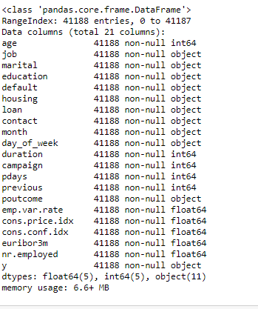
Data Exploration

Slide 10
Above we can see that there are 10 numerical columns having 5 columns of integer datatype and 5 columns on float datatype and 11 are categorical datatype including target variable which is named as y in the dataset.

Slide 11
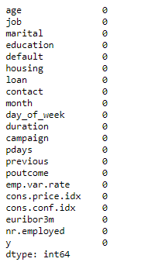
Checking for null/missing values

Slide 12
There are no null/missing values in a dataset.

Slide 13
Type of data available for analysis:
The type of data available for analysis is the Exploratory Data Analysis (EDA). The goal of using Exploratory Data Analysis(EDA) is:
To explore data and find relationships between variables which were previously unknown.
It’s also helps you to discover relationships between measures in your data, which are evidence for the existence of the correlation.

Slide 14
Exploratory Data Analysis
Why Exploratory Data Analysis(EDA) ?
One of the reason for doing some Exploratory Data Analysis(EDA are as follows:
To ease the burden when doing some machine learning tasks. Machine learning tasks typically start with a comprehensive exploration of the datasets.
Its helps ML practitioners to gain a deeper understanding of the properties of the data(schema, statistical properties, and so on),the quality of the data(missing values, inconsistent data types, and so on) and the predictive power of the data(for example, the correlation of features with the target).
Can accomplish the task of performing some descriptive analysis which provides an understanding of the characteristics of the dataset and performing some visualizations which presents data in a pictorial or graphical format.

Slide 15
I’m going to perform some Exploratory Data Analysis(EDA) using the “bank-additional-full.csv” dataset.
With the help of the libraries such as matplotlib and seaborn, our goal to perform some exploratory data analysis can be easily accomplished. I will reveal some insights which I’ve developed.

Slide 16
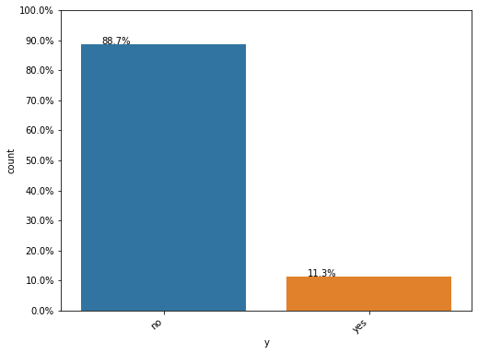
EDA Categorical Variables:
I will first perform some exploratory data analysis on the categorical variables.
In which class does majority data points belongs to? Yes, or no?
As shown from the plot, we can see that majority of datapoints belong to No class labels with 88.7% and minority of class belongs to 11.3% so the ratio of No:Yes is 8:1.

Slide 17
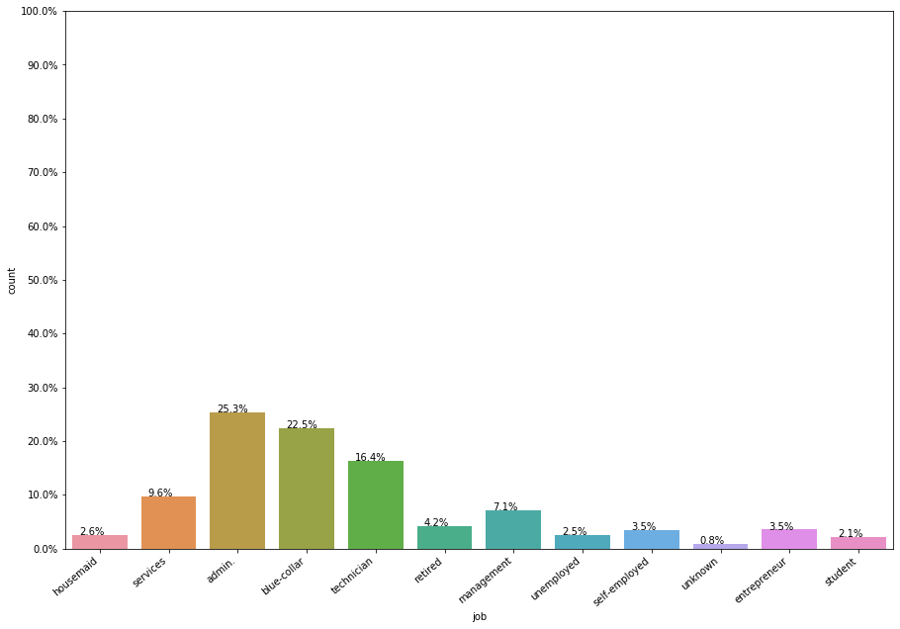
Univariate Analysis EDA
Let’s start doing EDA on rest of the columns of the datapoints.
Feature: Job (Categorical variable)
From the graph we can see that most of the customers that have jobs as "admin", "blue-collar" or "technician" have been contacted by the bank.
One interesting thing to find out would be to see the distribution for each classes as well.
For example, how many people who work as an admin have subscribed a term deposit.

Slide 18
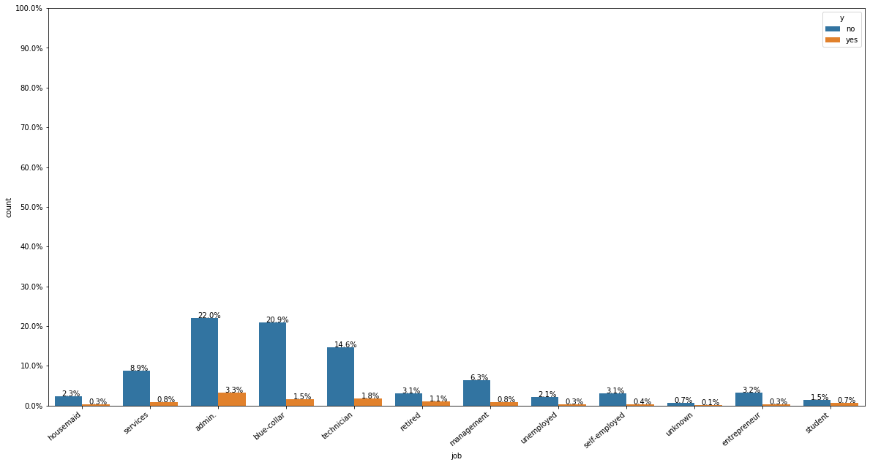
Which job profession has the highest rate for subscribing a term deposit and which has the highest rate of not subscribing?
From the plot, we can see that the customers who have jobs of admin have the highest rate of subscribing a term deposit
They are also the highest when it comes to not subscribing.
This is simply because we have more customers working as admin than any other profession.

Slide 19
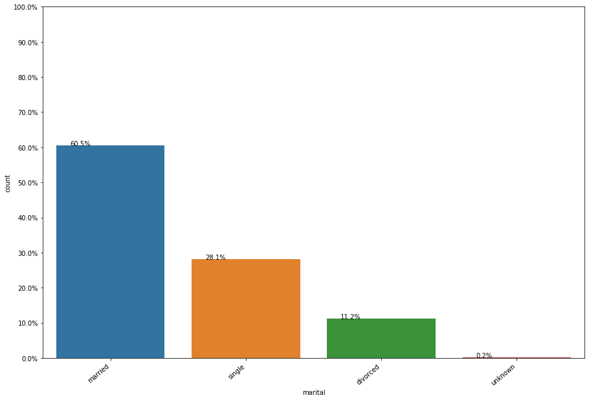
Feature: Marital (Categorical feature)
From the plot as we can see, customers who have been contacted the most are married.
About 0.2% of marital status of customer is unknown.

Slide 20
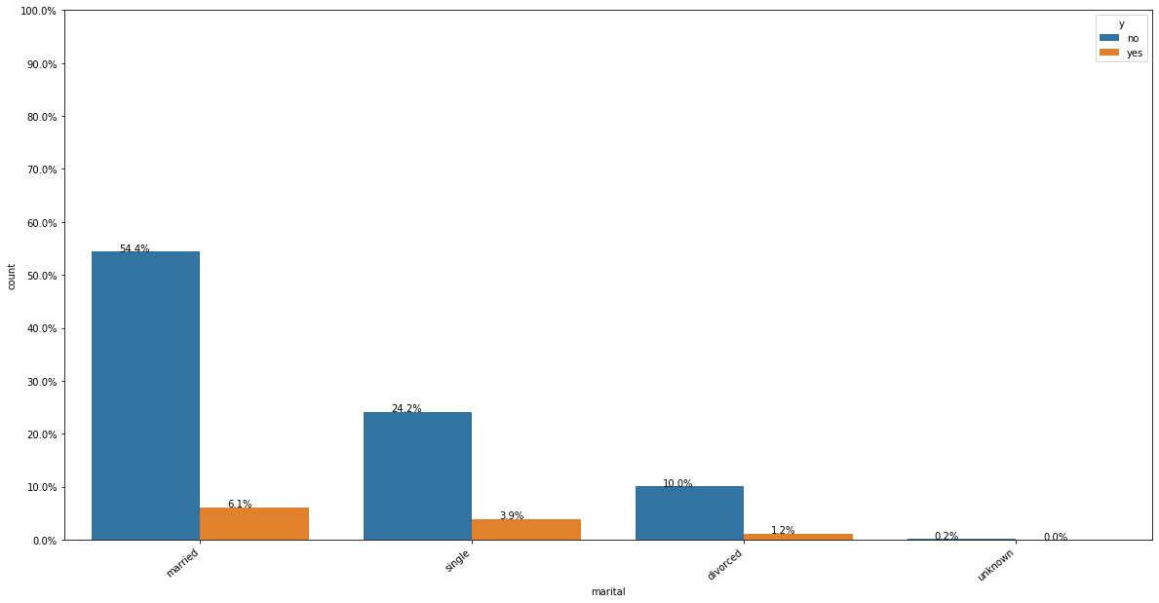
Which marital status subscribes the most for long term deposits?
From the plot we can see that married people has subscribed for long term deposits more than any other people with any marital status.
They are also the most one’s who have turned down the deposits offered by the bank.
People whose status is unknown has not subscribed to the long-term deposits at all.

Slide 21
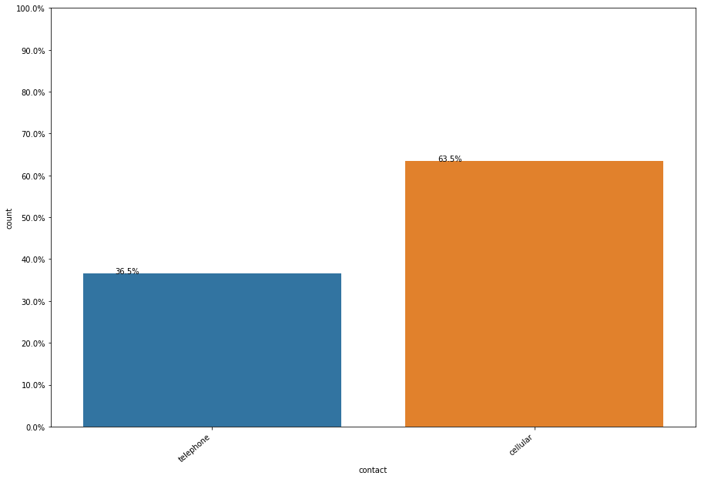
Feature: contact (Categorical)
As shown above, most people are contacted more in cellular than telephone.

Slide 22
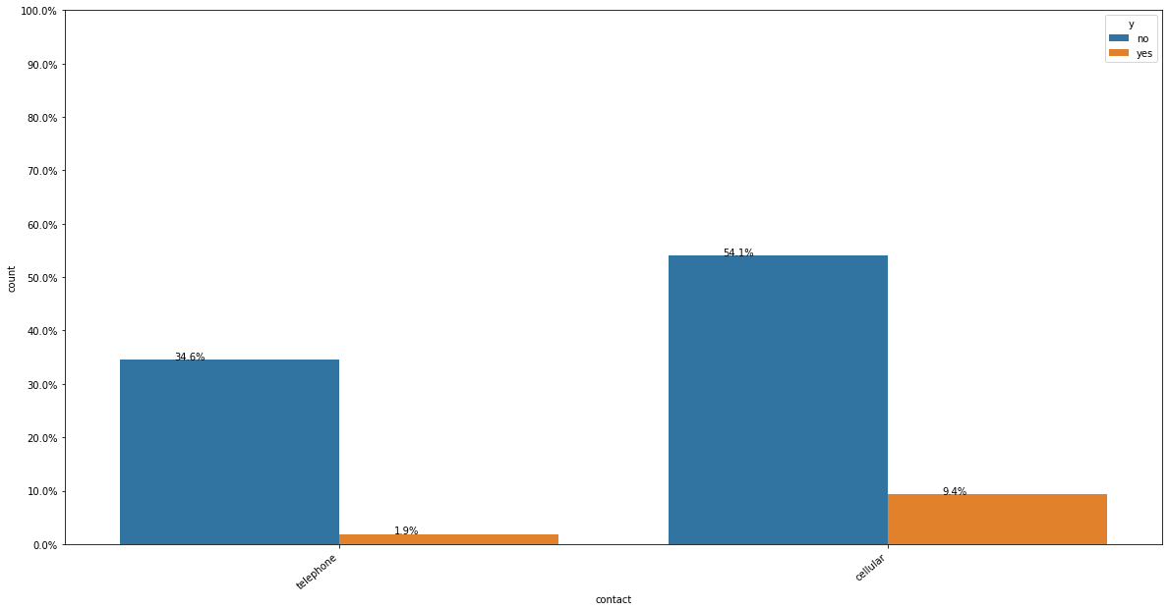
Which contact type has subscribed the most for long term deposits?
People with contact type cellular have subscribed more for long term deposits than telephone.

Slide 23
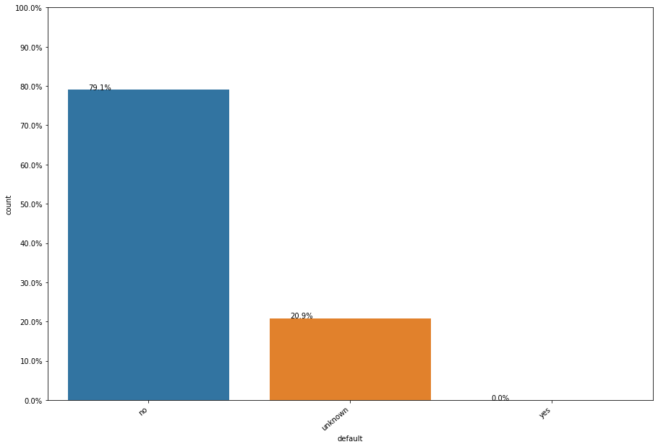
Feature: default (categorical)
As shown from the plot, we can clearly see that the people with default status as ‘no’ are the most who have been contacted by the bank for the deposits.
People with default status ‘yes’ have not been contacted by the bank at all.
While very few people with unknown default status have been contacted by the bank.

Slide 24
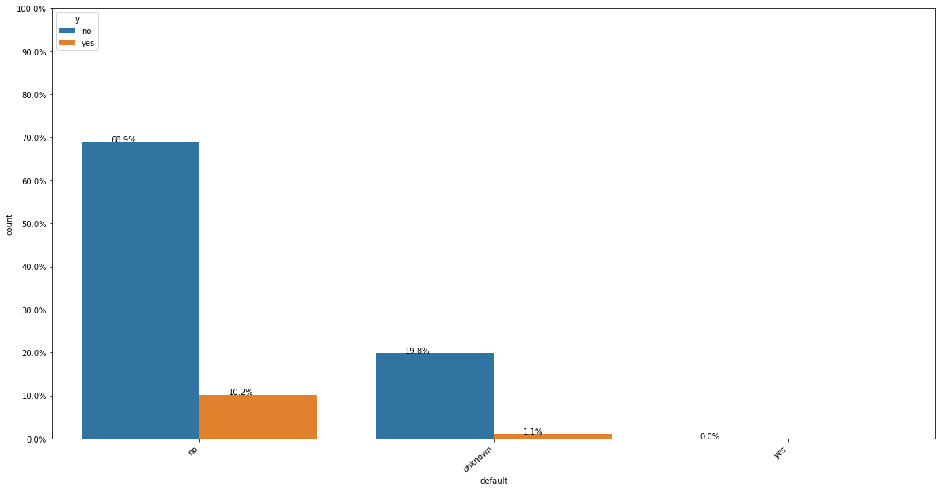
Do people who have or who don’t have credit in default subscribe the most for long term deposits?
From the plot we can observe that people with default status as no are the most one’s who have and have not subscribed for bank deposits.

Slide 25
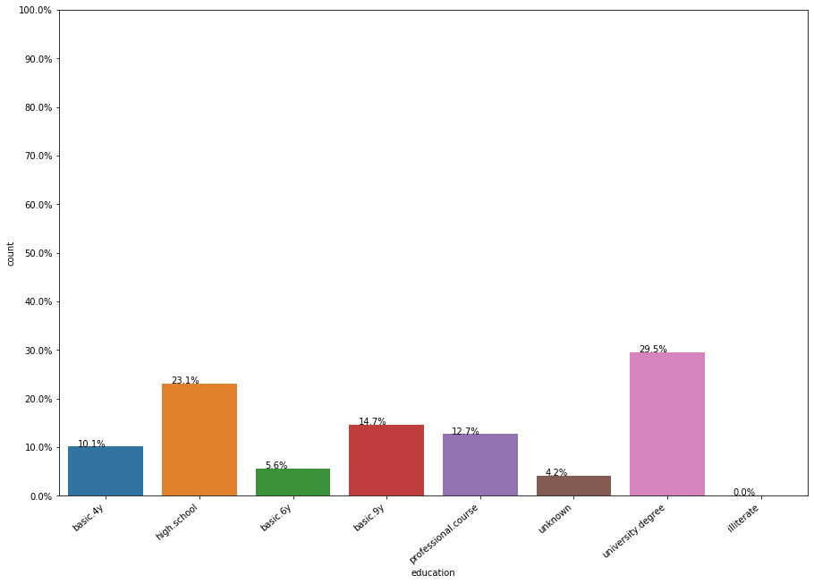
Feature: Education
As shown from the plot, people contacted by the bank with university degree as their educational qualification are more than the people with any other educational qualification.

Slide 26
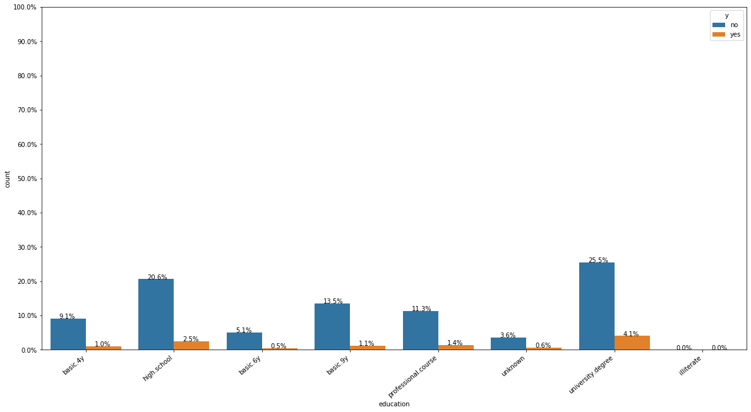
Do people who have completed their university degrees tend to subscribe the most for long term deposits?
As shown from the plot, people with university degree as education qualification are the most who have subscribed for the deposits. They are also the most who have not subscribed for deposits.

Slide 27
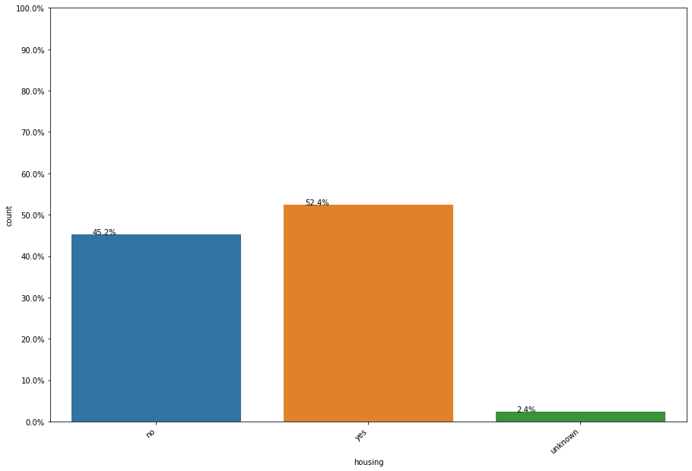
Feature: housing (Categorical)
People who have housing loan have been contacted the most by the bank.
People who have no housing loan has also been contacted pretty much, and people who have status unknown have been least contacted.

Slide 28
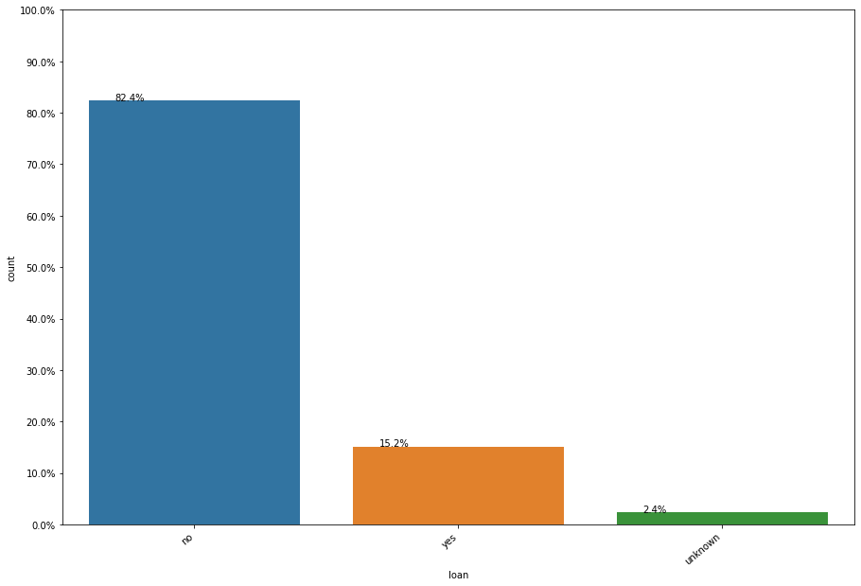
Feature: loan (Categorical)
As shown from the plot,people who do not have loans have been most contacted for longer term deposits than the ones who have loans.

Slide 29
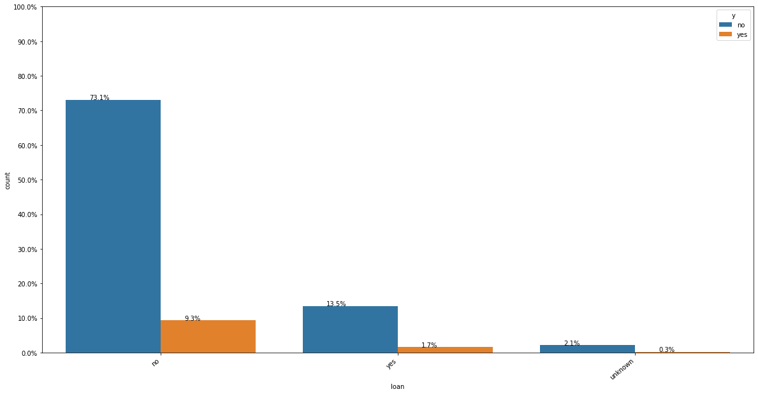
Do people with or without loans subscribed the most for long term deposits?
People with no personal loan have subscribed the most for long term deposits.
They are also the ones who have not subscribed for long term deposits.
People are being contacted the most in the month of May than any other months.
It is followed by July, August, June.
Very few people have been contacted in the month of December.
People have not been contacted in the month of January and February.

Slide 30
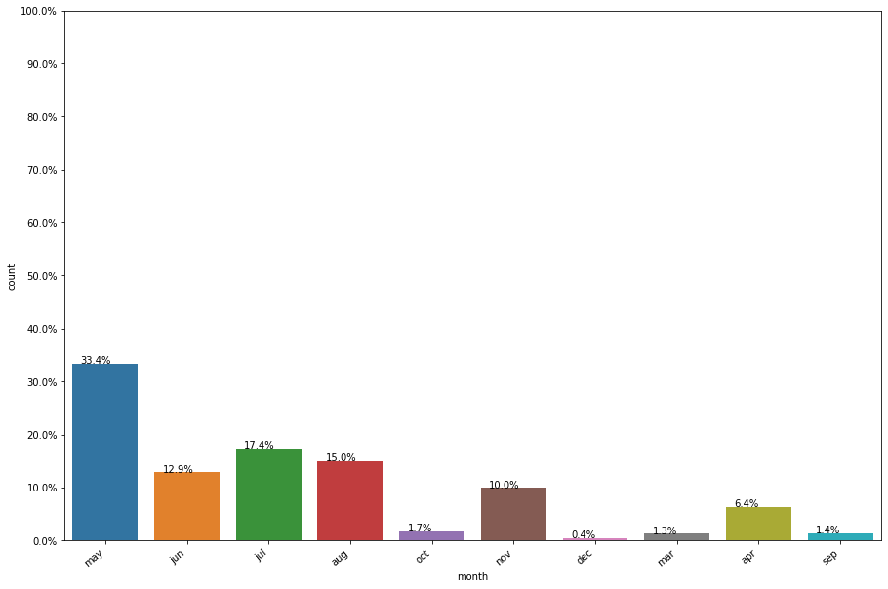
Feature: month (Categorical)
People are being contacted the most in the month of May than any other months.
It is followed by July, August, June.
Very few people have been contacted in the month of December.
People have not been contacted in the month of January and February.

Slide 31
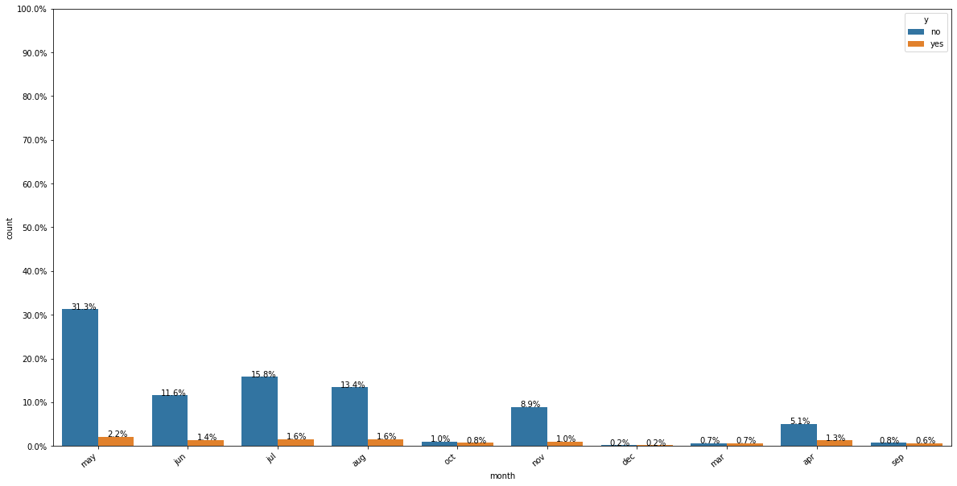
In which month do people have higher chances to subscribe for longer term deposits?
People who have been contacted in May have higher chances to subscribe for longer term deposits but have also higher chances for not subscribing the long-term deposits.
Very few people are contacted in the month of December, March, September, and October and have almost equal chances for subscribing the deposits or not.

Slide 32
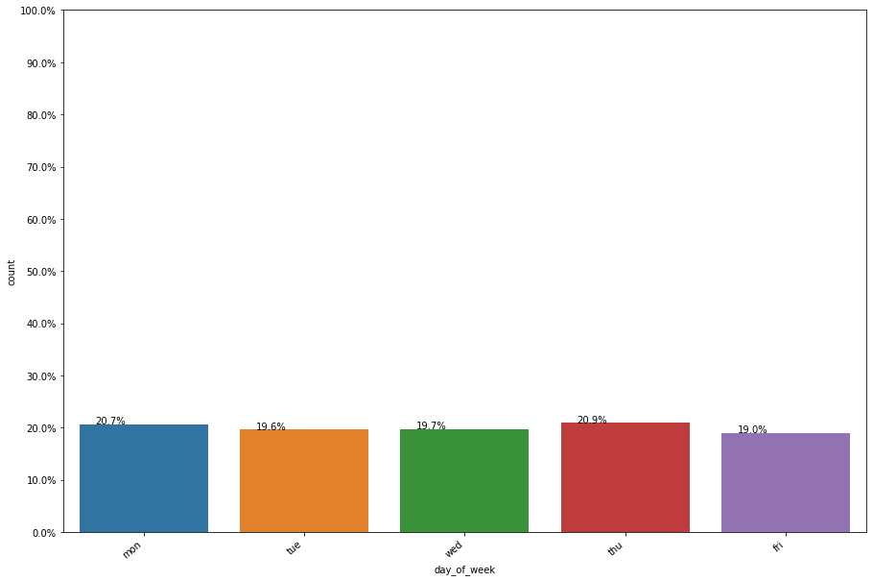
Feature: day_of_week (Categorical)
From the plot we can see that people are contacted from Monday to Friday but not on Saturday and Sunday.

Slide 33
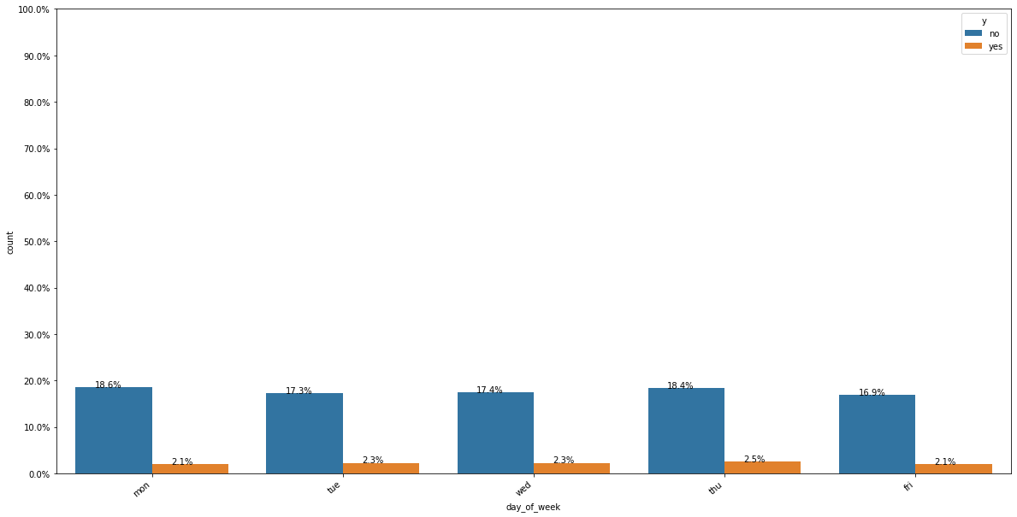
Does in all days people have equal chances for subscribing or not subscribing for the long-term deposits?
As shown from the plot, in all the days they have equal chances for subscribing and not subscribing the term deposits.
Day_of_week may not be very helpful in predicting whether the customer will subscribe for long term deposits or not.

Slide 34
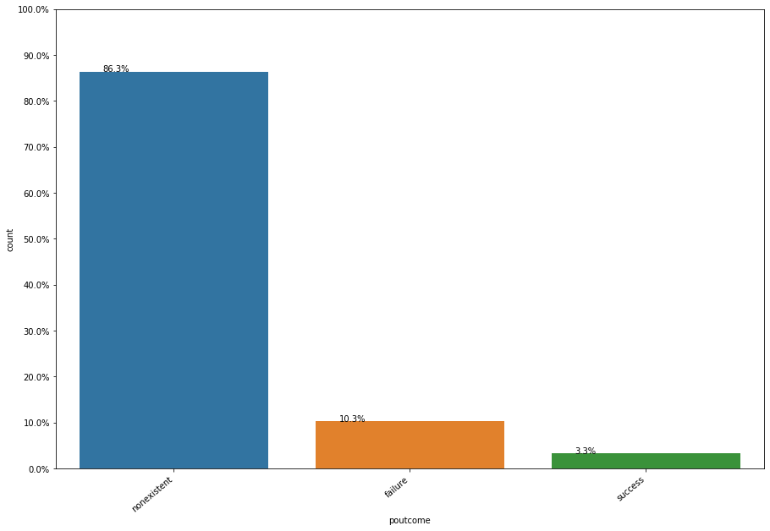
Feature: poutcome (Categorical)
As shown from the plot it is evident that majority of outcome of previous campaigns are nonexistent.
Very few people from previous marketing campaigns have subscribed for long term deposits.

Slide 35
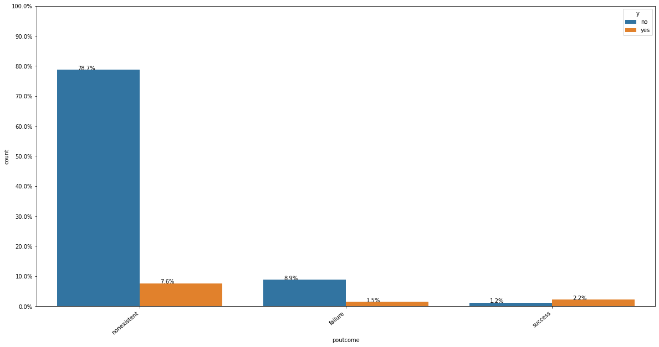
Which previous outcome has subscribed the most?
As we can see, people whose previous outcome is non-existent has subscribed the most than any other group of people belonging to previous outcome.
It is also clear that people belonging to success category of previous outcome has turned down for longer deposits.

Slide 36
EDA Numerical Variables:
Now will I perform some exploratory data analysis on the numerical variables.

Slide 37
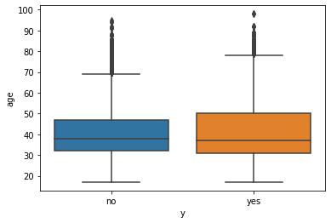
Feature: age (Numeric)
From the plot as shown ,we know that for both the customers that subscribed or didn't subscribe a term deposit, has a median age of around 38-40, and the boxplot for both the classes overlaps quite a lot, which means that age isn't necessarily a good indicator for which customer will subscribe and which customer will not.

Slide 38
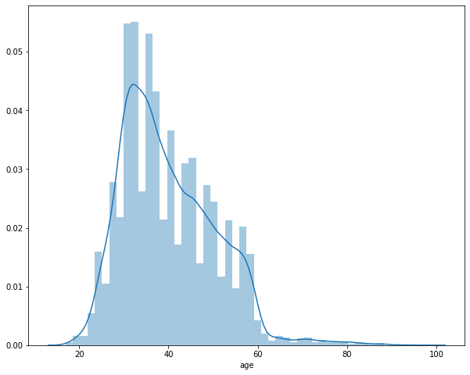
From the plot as shown below ,it is a right skewed graph and there is an evidence of outliers after the age of 60. We also see in the distribution that most of the customers are in the age range of 30-40.

Slide 39
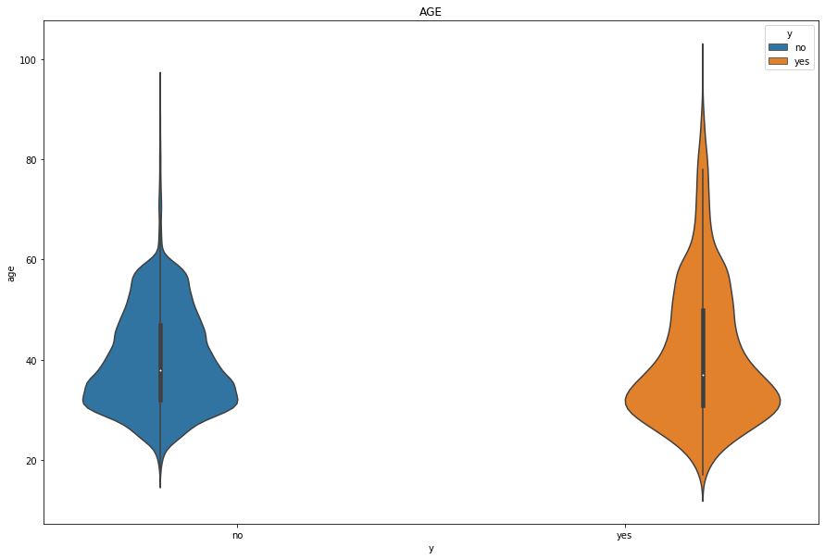
However, we can use other plots to check for outliers ,Violin plot and box plot.
Using the Violin plot as shown , it is clearly visible that there are outliers present for both the class.
In No class, outliers are present above age 70 and for Yes class, outliers are present above age 75.
Median for No class is around 40 which is same for Yes class.
Also, it is visible that IQR range is almost overlapping so age might not be very helpful in predicting class label.

Slide 40
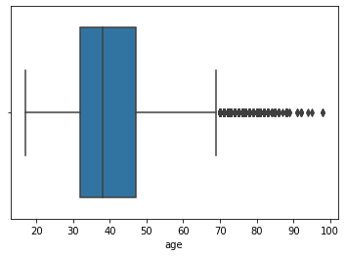
Using the box plot as shown , we can say that outliers are present after the age of 70 years.

Slide 41
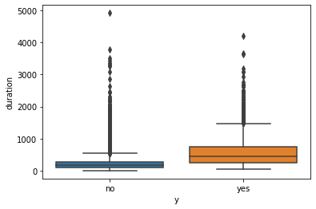
Feature: duration (numeric)
From the plot as shown, the duration (last contact duration) of a customer can be useful for predicting the target variable.
It is expected because it is already mentioned in the data overview that this field highly affects the target variable and should only be used for benchmark purposes.

Slide 42
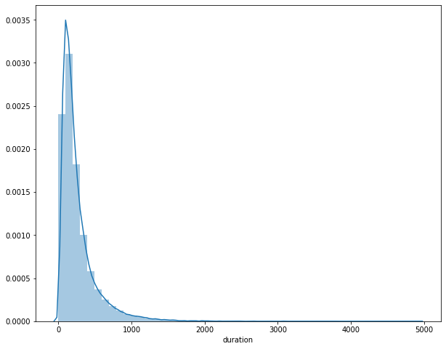
As shown from the plot ,it is clear that from duration around 1500 onward outliers, are present and it is right skewed data.
In this distribution above we find where most the values are very low and very few have high values.

Slide 43
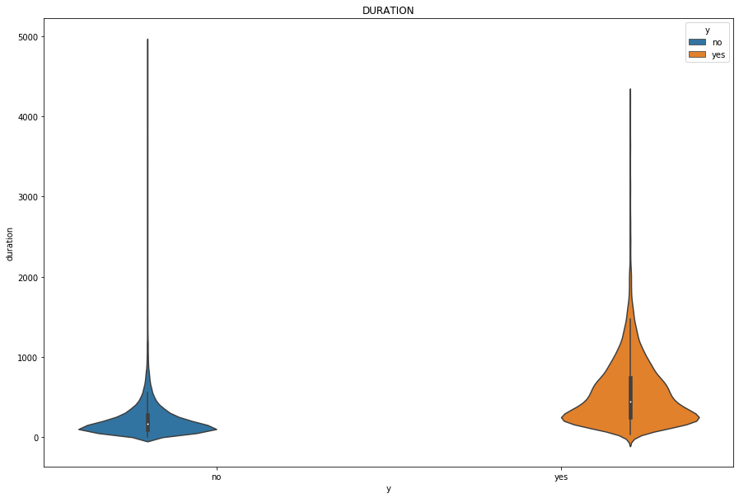
Using the Violin plot as shown , any duration of call with class labels as no, more than 1000 are considered as outliers while with class labels as yes, more than 1500 would be considered as outliers.

Slide 44
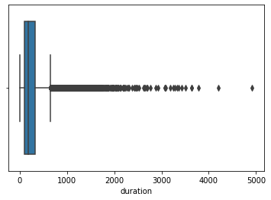
Using the box plot as shown , we can say that outliers are present after the duration of calls more than 1000.

Slide 45
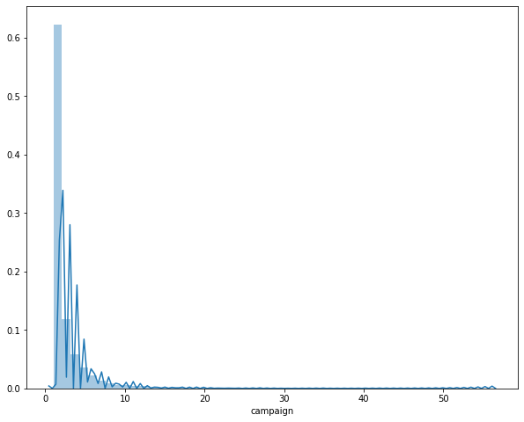
Feature: campaign (numeric)
As we can see from the plot, outliers might be present after the number of campaigns 10.

Slide 46
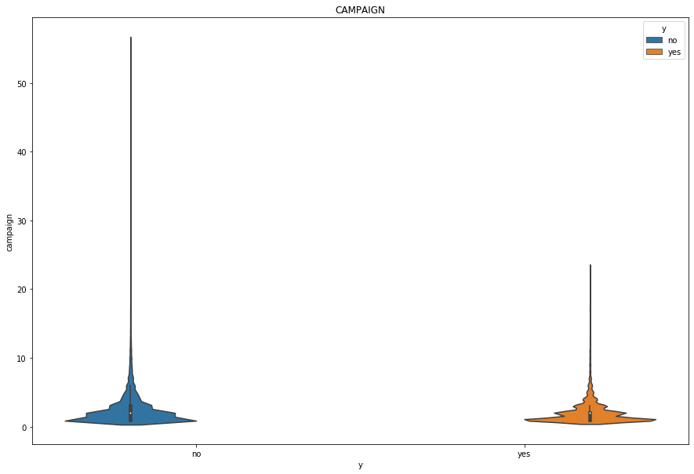
Outliers are present when number of campaigns are more than 10 irrespective of any class labels.

Slide 47
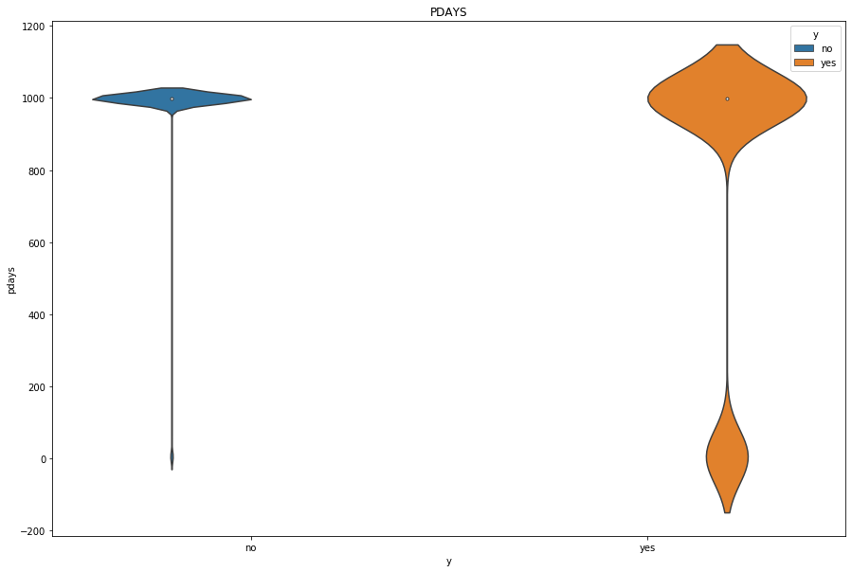
Feature: pdays (numeric)
From the Violin plot it is visible that irrespective of class labels, mostly people have not been contacted by the bank. Very people have been contacted by the bank and number of days passed for previous campaign is between 0–100.
It means we either must compute pdays or drop the pdays depends on the percentage of values.
Also, it is not very clear but the IQR range for the both the classes are overlapping.

Slide 48
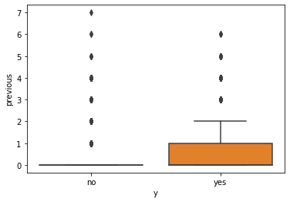
Feature: previous (numeric)

Slide 49
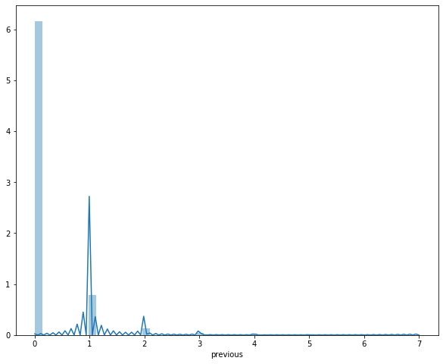
From the plot as shown , there might be outliers present after the number 4.

Slide 50
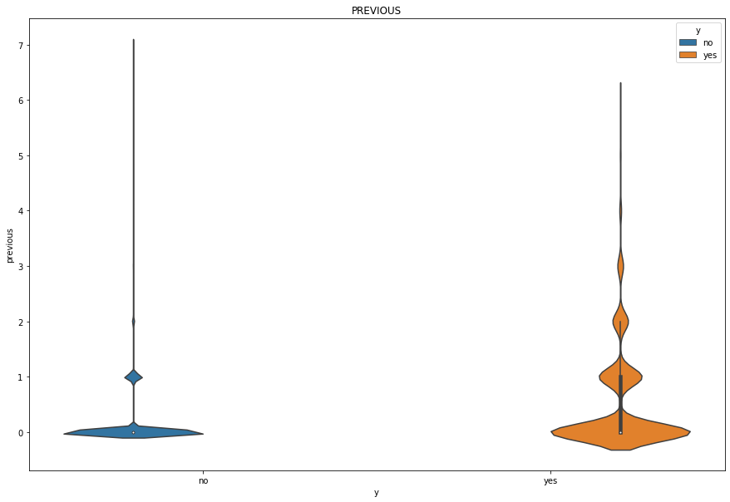
Using the Violin plot as shown as we can see, people who have contacted once for the previous campaign has subscribed for long term deposits.
For class no, there are so many outliers starting with value 1 but for yes class, outliers are present from value 3.
From the plot it is visible that previous feature would be helpful in predicting the class labels.

Slide 51
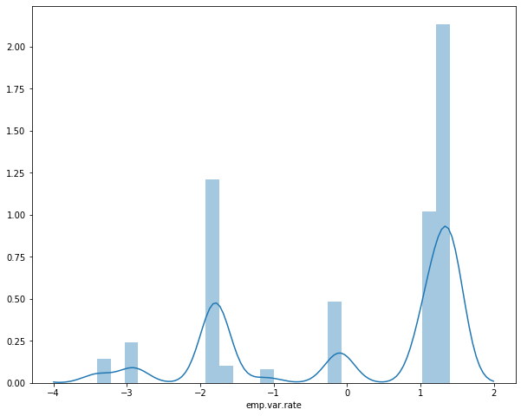
Feature:emp.Var.Rate(numeric)
From the plot it is visible that there are no outliers present.

Slide 52
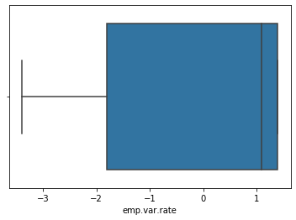
No outliers are present as shown on the boxplot.

Slide 53
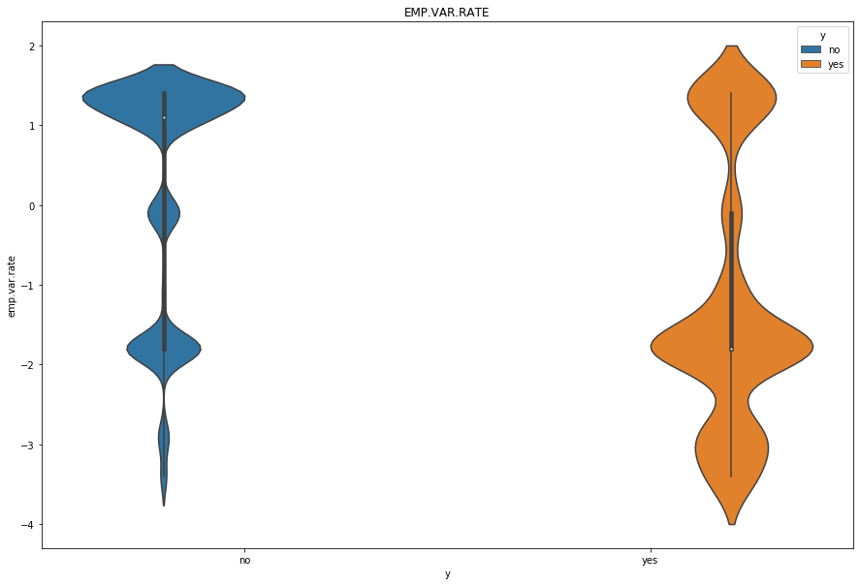
There are no outliers present for any class for this feature and emp.var. rate feature would be very useful in predicting labels.

Slide 54
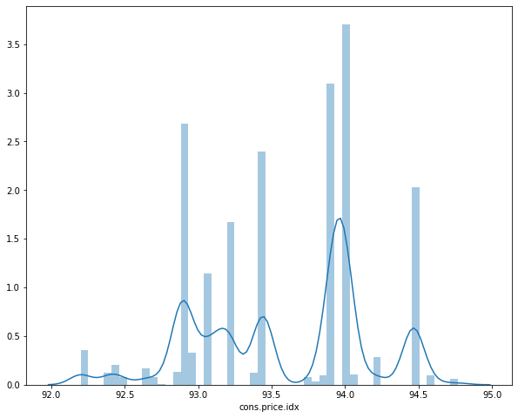
Feature:cons.price.idx(numeric)
From the plot we can see that there are no outliers present.

Slide 55
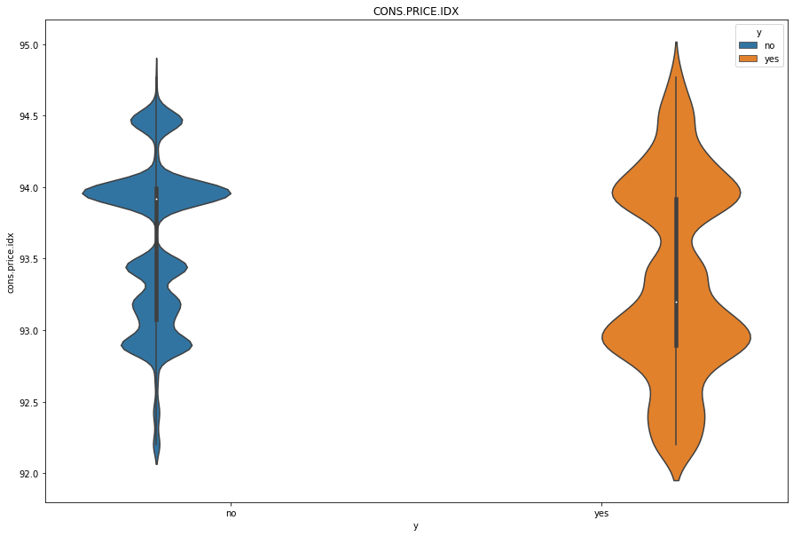

Slide 56
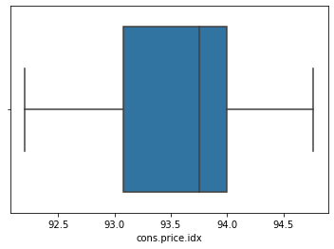

Slide 57
From the 2 plots above, cons.price.idx does not contain any outliers and they would also be very much helpful in predicting class labels.

Slide 58
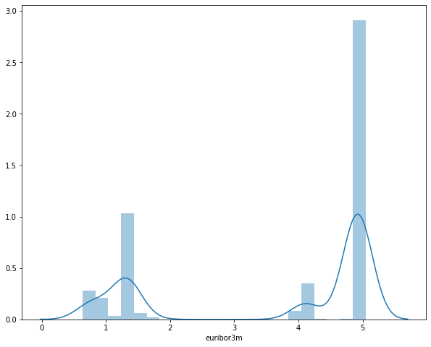
Feature:euribor3m(numeric)

Slide 59
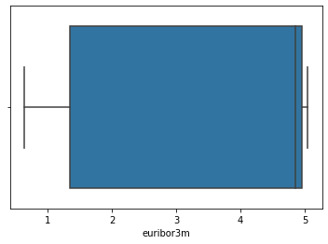

Slide 60
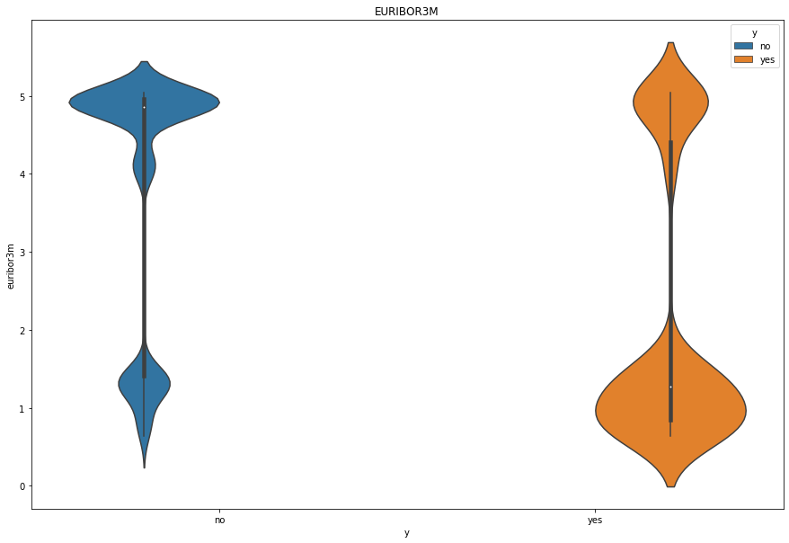

Slide 61
From the above plots,Euribor3m does not contain outliers and would be very much helpful in predicting the class labels.

Slide 62
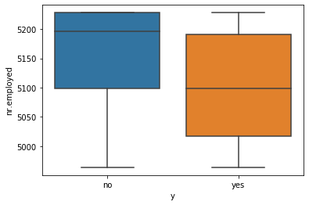
Feature:nr.employed(numeric)

Slide 63
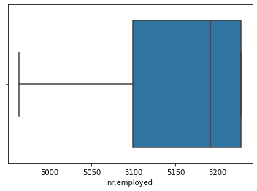

Slide 64
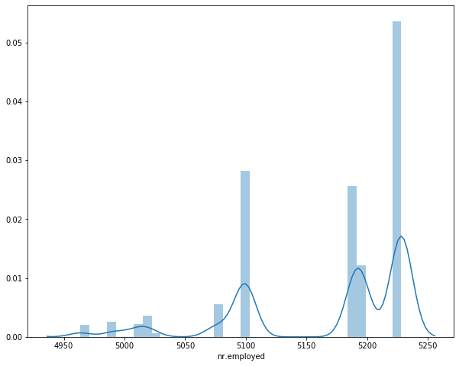

Slide 65
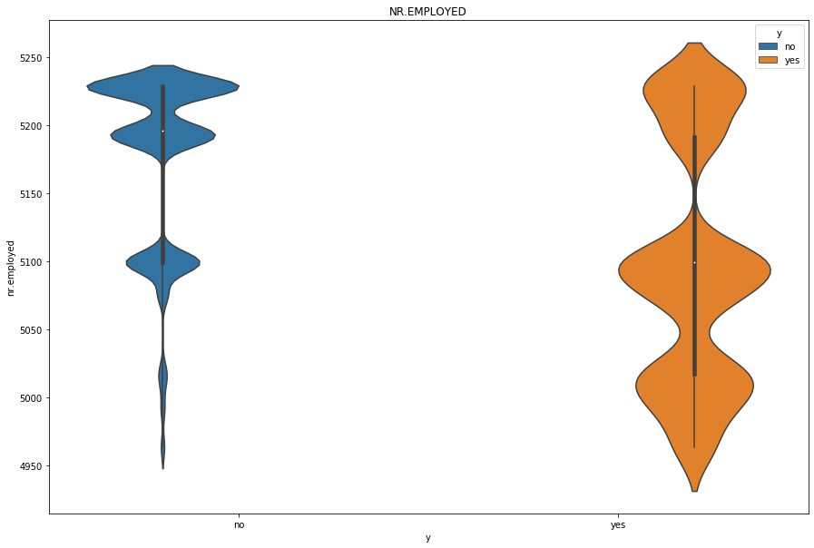

Slide 66
From the plots above , nr. employed does not contain outliers and nr. employed would also be very much helpful in predicting class labels.

Slide 67
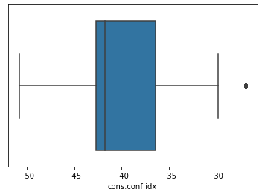
Feature:cons.conf.idx(numeric)

Slide 68


Slide 69

From the plot there might be a case of outliers. Let’s check with violinplot.

Slide 70

In cons.conf.idx feature for class labels no, there is an outlier present when value above -30.

Slide 71

Correlation among features:
Pearson correlation used.
Let’s check for correlation of features between the numerical features.

Slide 72
Some numerical features which share a high correlation between them, e.g., nr. employed and euribor3m these features share a correlation value of 0.95, and euribor3m and emp.var. rate share a correlation of 0.97, which is very high compared to the other features that we see in the heatmap.

Slide 73
Feature Engineering:
Is the process of converting data into features that improves the prediction and performance of model in unseen data.

Slide 74
Converting an age(numerical) variable to a categorical variable.
Here I have created 9 groups from minimum age 10 to maximum age 100.
After creating, inserted the age group into data frame and deleted the age column from the data frame.

Slide 75
Creating i_loan column; Deleting Housing and Loan column
I have created i_loan based on the columns['loan','housing'], status we have 3 statuses yes, no, unknown.
If any 2 columns have status yes then ,i_loan will have yes as status, if any of the columns have no as status, then i_loan will have no as status or else unknown status.

Slide 76

Which age group has the bank contacted the most?
As shown , the bank has contacted to the most between the age group of 30-39 followed by 40-49.

Slide 77

Which age group is most likely to subscribe for long term deposits?
Age group of 30-39 are the most people who have not subscribed for the deposits.
They are also the most who have subscribed for the deposits

Slide 78

Age_group and campaign
Number of campaigns from 1-7 and age above 70 has possible outliers.

Slide 79

Age_group and previous
For number of previous campaigns from 0-1 age group above 70 are possible outliers.
For number of contacts for previous campaigns as 2, age around 90 are possible outliers.
For number of previous campaign from 3-4 age around 80 are possible outliers.

Slide 80

Age_group and emp.var.rate
For emp.var.rate with -1.8 has most outliers above age around 60.

Slide 81

i_loan
Most of the people the bank has contacted either have personal or housing loan. Very few of the status of loan is unknown.

Slide 82

Do people who have loans are the most that have subscribed for deposits?
People who have loans are in majority who have subscribed for deposits.
They are also the ones who have not subscribed for the deposits.

Slide 83
For the other EDA of the following:
Age_group and job
Age_group and education
Age_group and i_loan
Education and job
Education and marital
I_loan and education
Marital and job
I_loan and marital
I_loan and job
you can check out and review the full code on the following GitHub repository link:

Slide 84
Recommendation summary
After I've conducted some analysis through visualizations using plots, it revealed as follows:
People who are in admin job has been more contacted for the deposits by the bank.
People who are married has been contacted more for the deposits by the bank.
People who has been contacted more on the cellular than the telephone.
People has been contacted more in the month of May than any other month. They have not been contacted in January and February at all.
People has not been contacted on Saturday and Sunday.
People with no default status has been contacted more by the bank.
People who has housing loan has been contacted more by the bank
People with no personal loan has been contacted more by the bank.
People who are in university has been contacted more by the bank.
Age,Duration,Campaign have outliers and are rightly skewed.
Pdays have more than 70% of data imputed so it is better either to impute or remove the column.
Euribor3m with nr.employed and emp.var.rate with nr.employed with the highest correlation.

Slide 85
Recommended models
Remember,our goal is to predict whether a customer will subscribe a term deposit or not given the data of the customer.
So, what type of machine learning problem is this?
This is a binary classification problem.
I have chosen the following models recommended for this problem:
Dummy Classifier(Stratified)
KNN-classifier

Slide 86
Logistic Regression
SGD-log loss
Linear SVM
Random Forest
XGBoost
Adaboost
Each of these models will be encoded with different encoding methods,with either One Hot Encoding or Response Encoding.
Recall:
One Hot Encoding:One hot encoding creates column for each category and checks
whether the category is present in that row or not. If category is present, it would be marked as 1 else zero.
Response Encoding: As part of this technique, we represent the probability of the data point
belonging to a particular class given a category. So, for a K-class classification problem, we get K new features which embed the probability of the datapoint belonging to each class based on the value of categorical data.

Slide 87
Data modelling steps:
The duration variable will only be used for baseline model.Since to make the models realistic we would be dropping column for other machine learning models.
Hyper tuning of models has been done, using calibrated classifier, where cross validation dataset is used to get best hyper parameter.
After getting best hyper parameter, train and test data set is used for evaluating the model performance.
Feature scaling of numerical data is done only for linear models. Tree based models does not require feature scaling and is also robust to outliers.
For each encoding of categorical data, we have used models to compare which encoding would work better.
Since the dataset is highly imbalanced, I have used class_weight=’balanced’ as parameter to balance the dataset internally.

Slide 88
Calibrated Classifier
What is the need to use Calibrated Classifier?
Non-linear models like (KNN, Tree based Models) predicts uncalibrated probability. Though models predict probability, but they might not be the same like observed probability in training. It requires adjustment and that is done by calibration.

Slide 89
Performance metric
For this problem I will be using the ROC-AUC curve.
The ROC –AUC curve shows the performance of binary class classifiers across the range of all possible threshold plotting between true positive rate and 1-false positive rate.
Measures the likelihood of that given two random points one from positive and one from negative the classifier will rank the positive points above negative points.
Is a popular classification metric that present the advantage of being independent of false positive and false negative.
The ideal AUC score is 1 and AUC of 0.5 is for random classifier.

Slide 90
Other performance metrics required
Macro-F1 score
Macro-F1 Score: F1 score is the harmonic mean between Precision and Recall.
Macro F1 score is used to know how our model works in overall dataset.
Confusion Matrix:
This matrix gives the count of true negative,true positive,false positive and false negative datapoints.

Slide 91
Model building
I will first begin with the machine learning models encoded using One Hot Encoding method.
The following machine learning models are:
Dummy Classifier(Stratified)
KNN-classifier
Logistic Regression
SGD-log loss
Linear SVM
Random Forest
XGBoost
Adaboost

Slide 92
After I’m done with the machine learning models encoded using One Hot Encoding,then
I will go with machine learning models encoded using Response Encoding method.
Then I will measure the performance of each of these machine learning models using the metrics ,
AUC score and F1-score.
I will then select the best or champion model with the highest score.

Slide 93

1. Dummy Classifier(Stratified) One Hot Encoding
Strategy with Stratified has the best AUC score among other strategies,and that is why it is selected.

Slide 94

For the Dummy Classifier ,we get a Train AUC Score of 0.4957 and a Test AUC score of 0.4778. This is not a good performance. Now let's look at the F1 score .

Slide 95
We get a Train F1-score of 0.4709
and a Test F1-score of 0.4691.
This is not a good performance either when measuring with the F1-score.
Overall, the performance of the Dummy Classifier(Stratified) machine learning model encoded using One Hot Encoding method is not good.
Let's work with the other machine learning models encoded with One Hot Encoding maybe they can perform better than this.

Slide 96

2.K-Nearest Neighbour
Using the K-Nearest Neighbour,the best K value is 21.Lets find the AUC score and the F1-score.

Slide 97

For the K-Nearest Neighbour machine learning model we get a Train AUC score of 0.8353 and a Test AUC score of 0.7125.
This indicates a good performance.Now let's look at the F1-score.

Slide 98

We get a Train F1-score of 0.6064 and a Test F1-score of 0.5556 for the K-NN model.
This is not bad.Now let's work with the Logistic Regression model.

Slide 99

3.Logistic Regression
Using the Logistic Regression model, we get a Train AUC score of 0.7711 and a Test AUC score of 0.7530.
This also indicates a good performance.Now let's look at the F1-score.

Slide 100

We get a Train F1-score of 0.6113
and a Test F1- score of 0.6029.
This is a slightly good performance.Now let's work with SGD Classifier with log-loss machine learning model.

Slide 101

4.SGD Classifier with log-loss
Using the SGD Classifier with log-loss we get a Train AUC score of 0.77 and a Test AUC score of 0.7535.
This also indicates a good performance. Now let's look at the F1-score.

Slide 102

The Train F1-score is 0.6119 and the Test F1-score is 0.6149 for the SGD Classifier with log-loss.
This is also indicating a slightly good performance.Now let's work with the Linear SVM machine learning model.

Slide 103

5.Linear SVM
We get a Train AUC score of 0.7632 and a Test AUC score of 0.7496.
This indicates a good performance.Now let's look at the F1-score.

Slide 104

We get a Train F1-score of 0.5891 and a Test F1-score of 0.5894.
This is not a bad.Now let's work with Random Forest model.

Slide 105

6.Random Forest
Using the Random Forest model, we get a Train AUC score of 0.9975 and a Test AUC score of 0.7730.
This indicates a very good performance.Now let's look at the F1-score.

Slide 106

We get a Train F1-score of 0.8180 and the Test F1-score of 0.6092.
This indicates a good performance for the Train F1-score and a slight good performance for the Test F1-score.Now let's work with the Xgboost machine learning model.

Slide 107

7.XGBoost Classifier
The Train AUC score is 0.8367 and the Test AUC score is 0.7937.
This indicates a very good performance.Now let's look at the F1-score.

Slide 108

We get a Train F1-score of 0.6783 and a Test F1-score of 0.6489.
This indicates a slight good performance.Now let's look at the Adaboost machine learning model.

Slide 109

8.Adaboost
We get a Train AUC score of 0.8166 and a Test AUC score of 0.7924.
This indicates a good performance.Now let's look at the F1-score.

Slide 110

The Train F1-score is 0.6361 and the Test F1-score is 0.6270.
This is a slightly good performance.I’ve finished working with all the machine learning models encoded using One Hot Encoding method,now I will be working with the machine learning models encoded using Response Encoding method. I will be working with the same models in the preceding examples.

Slide 111

1. Dummy Classifier(Stratified) Response Encoding
As we can see, the Train AUC score is 0.5050 and the Test AUC score is 0.5013.
This is not bad.Now let's look at the F1-score.

Slide 112

We get a Train F1-score of 0.4709 and a Test F1-score of 0.4691.
This is a bad performance.Now let's work with K-NN model.

Slide 113

2.K-Nearest Neighbour
Using the K-Nearest Neighbour algorithm,we get a Train AUC score of 0.8278 and a Test AUC score of 0.7236.
This indicates a good performance.Now let's look at the F1-score.

Slide 114

The Train F1-score is 0.6347 and the Test F1-score is 0.6077.
This indicates a slightly good performance.Now let's work with Logistic Regression model.

Slide 115

3.Logistic Regression
We get a Train AUC score of 0.7630 and a Test AUC score of 0.7481.
This indicates a good performance.Now let's look at the F1-score.

Slide 116

The Train F1-score is 0.6066 and the Test F1-score is 0.6360.Now let's work with the SGD with log-loss.

Slide 117

4.SGD with log-loss
We get a Train AUC score of 0.7631 and a Test AUC score of 0.7475.
This indicates a good performance.
Now let's look at the F1-score.

Slide 118

The Train F1-score is 0.6043 and the Test F1-score is 0.6710.Now let's work with Linear SVM model.

Slide 119

5.Linear SVM
Using the Linear SVM model we get a Train AUC score of 0.7633 and a Test AUC score of 0.7436.
This indicates a good performance.Now let’s look at the F1-score.

Slide 120

The Train F1-score is 0.5960 and the Test F1-score is 0.1042.
The Test F1-score is very bad compared with the Test F1-score of all the other models.Now let’s work with Random Forest model.

Slide 121

6.Random Forest
The Train AUC score is 0.9974 and the Test AUC score is 0.7725.
This indicates a very good performance.Now let’s look at the F1-score.

Slide 122

We get a Train F1-score of 0.8046 and a Test F1-score of 0.5861.
Now let's work with the Xgboost model.

Slide 123

7.Xgboost
We get a Train AUC score of 0.8877 and a Test AUC score of 0.7902.
This indicates a very good performance.Now let’s look at the F1-score.

Slide 124

The Train F1-score is 0.7213 and the Test F1-score is 0.6473.
This indicates a slight good performance.Now let's work with the last machine learning model,Adaboost.

Slide 125

8. Adaboost
Using the Adaboost model, we get a Train AUC score of 0.8176 and a Test AUC score of 0.7942.
This indicates a very good performance.Now let's look at the F1-score.

Slide 126

The Train F1-score is 0.6391 and the Test F1-score is 0.6656.
This indicates a slightly good performance.Now let's select the best or champion model.

Slide 127

Model Selection

Slide 128
Let’s compare our Models and check which model is performing the best.
From the above we can see that model with Adaboost with response encoding has best Test-AUC score of 0.7942
and best F1-score of 0.6656 among other models.
We would be saving xgboost using joblib library to predict the data.
Therefore, we would require this model for deployment.

Slide 129
Thank You

